Slide 1
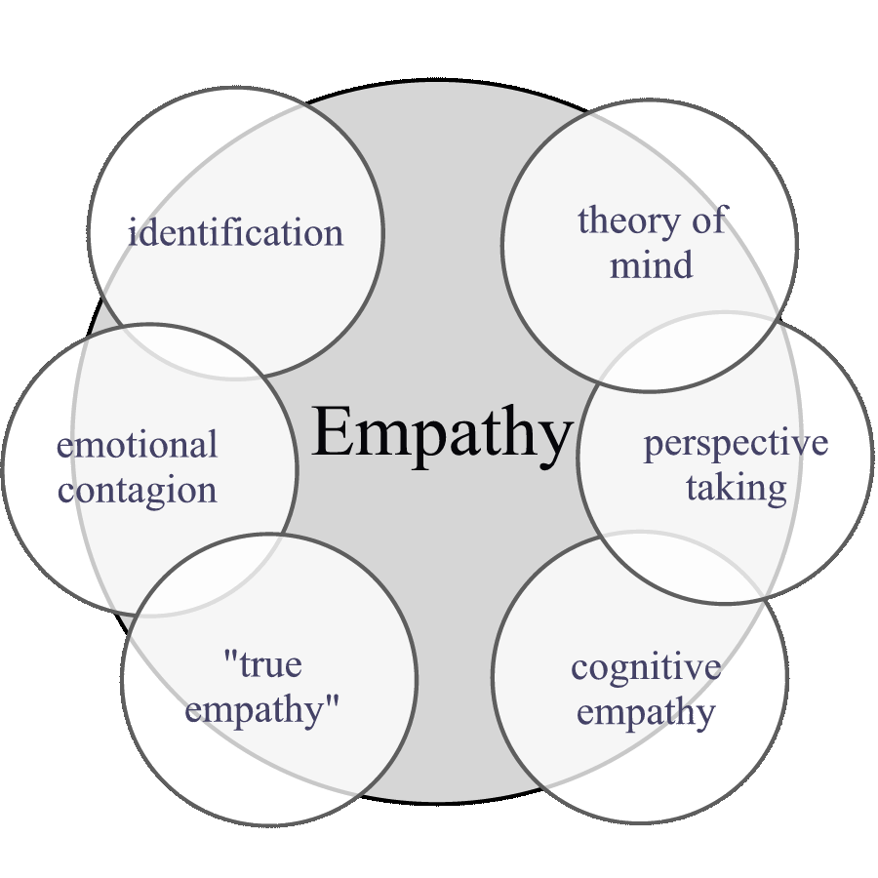

A Global empathetic European consciousness policy for Non-Western Immigrants, Expats and Extended Family
Dr Carl H.D. Steinmetz
Amsterdam The Netherlands
World Innovation Congress, Brussels
5 and 6 June 2013

Slide 2
Structure
Examples
Background
Why Immigrants’ and Expats’ are at stake
Implementing a Global Empathetic consciousness

Slide 3

Examples
A Turkish Expat and his carrier opportunities at a Dutch consultancy business
A Moroccan Immigrant and the illegal certification of his Moroccan University degree on a vocational education level
The asylum paradox: producing ‘fog’ in the media

Slide 4

Background
Net immigration (2001) in Europe is 3.0 per 1.000 inhabitants. In the United States 3.1 per 1.000 inhabitants
In 2008 1.8 million non-western persons immigrated to Europe. The majority were Moroccans, China, India, Albania and Ukraine
In 2010 31.4 million European (6,3%) inhabitants were born in a non-western country. Non registered immigrants are not included

Slide 5
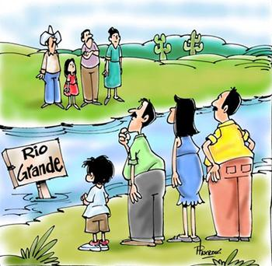
Laws of Ravenstein(1885)
Long-range immigrants usually move to urban areas
Rural dwellers are more immigratory than urban dwellers
Within their own country females are more immigratory than males, but males are more immigratory over long distances
Most immigrants are adults
Large towns grow more by immigration than by natural increase
Immigration increases with economic development

Slide 6

A new theory about immigration
Bauder (2006) suggests that all the international immigration of workers is necessary for the survival of industrialized economies. It turns the conventional fuel of international immigration on its head: it investigates how immigration regulates labor markets rather than labor markets shaping immigration flows

Slide 7
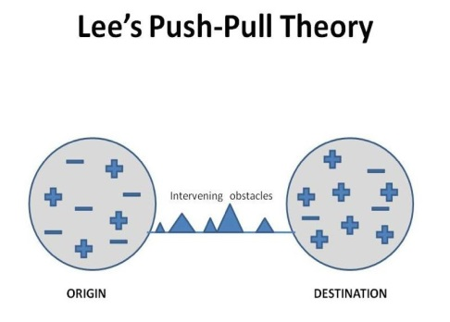
Lee’s Push-Pull Theory

Slide 8
Eurostat (2011): do immigrants benefit?
Labor market participation 1st generation unfavorable compared to native-born and nationals (in particular with with one child)
High levels of unemployment for both males and females, independent of education level
High risk of poverty for low SES immigrants, in particular in household with children. This goes hand in hand with poor housing conditions
The second generation immigrants perform better on the labor market but still less than the natives
High drop-out of second generation in education

Slide 9
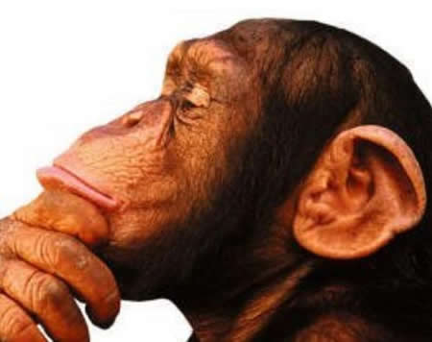
Conclusion
Although Lee (1966) may be right in the long run as has also been suggested by Scheffer discussing the position of Irish immigrants in United States of America (2007) these results cannot be explained otherwise than that the position of mainly non-western immigrants and expats in Europe are at stake.

Slide 10

Why Immigrants’ and Expats’ positions are at stake
From the perspective of Immigrants and Expats
From the perspective of the indigenous people
Protective factors against a negative outcome of immigration and expatriation

Slide 11
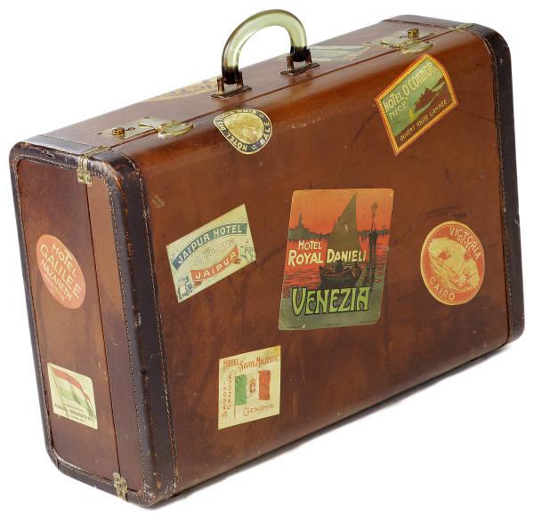
From the perspective of Immigrants and Expats
Akhtar (2011, 1999) says that ‘moving from where one has lived for a long time to a new place of residence can have destabilizing effects upon the mind with significant and lasting effects on an individual’s identity
Akhtar (1999) distinguishes the following factors affecting the outcome of immigration: a) temporary or permanent immigration (the difference between a diplomat and an immigrant), b) the degree of choice in leaving one’s motherland affects the subsequent adaptation (time available for preparation), c) the possibility of visiting one’s motherland, frequent international phone calls or skype sessions or refueling at other immigrant family members or homoethnic societies (frequent visitors suffer less than those who are barred from such ‘emotional’ refueling) and d) reasons for leaving have implications for success or failure of adapting to one’s fatherland (for instance escaping from persecution by family or state).

Slide 12

From the perspective of indigenous people
According to Akhtar (1999) the following reactions of the host population that affect the outcome of immigration or expatriation are:
The nature of the existing community
The particular era in which such immigration and expatriation takes place
The magnitude of cultural differences and bodily characteristics of the immigrants and expats

Slide 13

Protective factors against a negative outcome of immigration and expatriation
Women (oceans and continents)
Motherhood and local contacts
Young children
Women greater commitment to love relations than men (Freud, girls love change of mother to father)
Nesting instinct of women

Slide 14
Implementing a global empathetic consciousness
Pinker (2011) noticed that social scientists are revealing the hidden history of humans’ evolving ‘empathy over time and space with profound and far-reaching consequences for society and the fate of our species’. Pinker (2011) furthermore noticed that we, human beings, and other animal species, are living in the era of empathy

Slide 15
In other words, a policy of global empathetic consciousness, beneficial for Immigrants and Expats should consist of the following building blocks:
Be explicit about global empathetic consciousness by educating the Europeans about how to apply this consciousness.
Abandon the European users mentality, namely that only highly skilled expats and cheap labor force immigrants are welcome in Europe.
Invest in network information systems of immigrant families about fatherlands since the decision to immigrate to a certain location is based on this information system.
Invest in women since they are the ‘bridges’ between mother and fatherland.
Rely on the European notion of solidarity and responsibility for immigrants and expats.
Apply the rules of immigration (Ravenstein, 1885).

Slide 16
The Amsterdam experience with global empathetic consciousness
Homoethnic societies (mourning and refueling)
Provide education, embedding and labor (experience)
Extended family services
Intervention program for mothers
The promise for Europe if it implements this global empathetic consciousness policy for both Expats and Immigrants is less violence (Pinker, 2011), a more balanced population structure (no shift to ‘only’ elderly), more respect for differences between human beings and the ability to be tolerant, hopefully with the result that all Europeans and inhabitants of non-western countries will experience more prosperity.

Slide 17


