Slide 1

Expats at stake
More success by mourning , adapting and coping with acculturation stress
Eindhoven 14 April 2014

Slide 2

Structure
Introduction
My own experience as an expat
Expats: definitions and facts
Socio-psychological processes
Mourning and adaptation
The Internet Coach

Slide 3

Introduction
Adventurist on a long journey abroad
The next and necessary step in a carrier
Never mentioned are the psychological risks of failure or alienation
Never mentioned are risks of living apart from the extended family
Unclear are responsibilities (personal, multinational, governments in mother and fatherland) for a proper ‘landing’ of an expat. Excluded is the perspective of humans in a new human environment

Slide 4
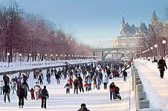

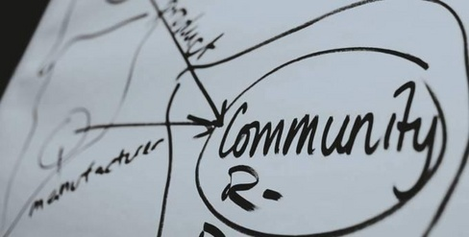
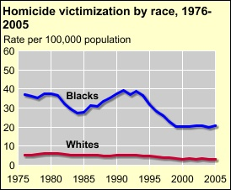
My own expat experience

Slide 5
My own experience as an expat
The Ministry of Justice arranged everything (income, extra living money, paper work)
Ottawa hotel to apartment (outside city, later downtown )
Vancouver: Bay Hotel to colleagues)
Transport (busses or biking)
Shopping (credit card)
Social Contacts (1T1 ok, manyT1 alienated)
Two cultures (Ottawa and Vancouver)
Traveling every week over long distances

Slide 6




Slide 7
Definitions expats
Multinational and expat (1-3 years?) and Commuter = Expat?
Expat: motherland > fatherland > motherland or new fatherland
Citizen> Expat> alien when returning motherland or excluded when becoming immigrant
Responsible for wellbeing Expat: motherland, fatherland and business/ multinational
Definition of responsibility: a) Economic, b) Practical (social services) and c) Psychosocial
If definition is unclear then the outcome data cannot be compared

Slide 8

Socio-psychological
Processes

Slide 9
Socio-Psychological
Expatriation # repotting a plant
Expatriation > adventure, migrate, rural or ocean to urban
Expatriation = (temporary) farewell to motherland
Expatriation = coping with a new identity transformation
Ideal result of expatriation = bi-culturalism (not assimilation or segregation)
Non Ideal result = individual of collectivist identity problem with key questions about retaining own culture and contacts/ participation with indigenous persons

Slide 10
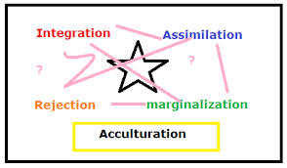
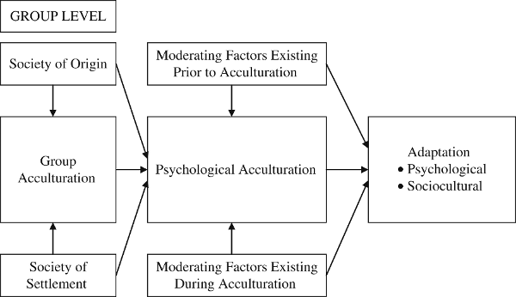

Slide 11
If psychological processes gone wrong
Enculturation = first culture learning
Acculturation = twofold, for the newcomer (dealing with the twilight zone) and the indigenous (non-excluding, not only favors for the own group, non- discrimination): if psychological gone wrong acculturation stress
If wrong Expatriation Trauma (Freud, 1917, Mourning and Melancholia)

Slide 12
Expat Measures according Akhtar (2011)
Repudiation (I do not have to mourn, I am going back)
Return (the fantasy of return is a someday fantasy)
Replication (the Expat wishes to replicate what she/ he has lost)
Reunion (the wish to capture an idealized past)
Reparation (the inner awareness that one has to repair propels sublimation and creativity)

Slide 13
Extended family and children
Collectivism = embeddedness (relatedness and interdependency)
Individualism = autonomy (independent)
Expatriation = risk of loss of support of extended family and years of stress, divorce, separation and failure
Expats = a preventive mother and children's program (with a focus on raising children in three cultures): mothers at stake

Slide 14
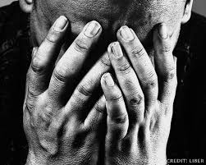


Mourning and adaptation in practice

Slide 15
A Poem(Gabriela Mistral)
I am two.
One looks back. The other turns to the sea.
The nape of my neck seethes with good-byes and my breast with yearning

Slide 16

Internet coach

